Slide 1
Attrition Data Analysis
Name : T Bhagya sree
Date : 08-10-2024

Slide 2
Agenda
Project Overview
Problem Statement
Data Source and Preparation
Dashboard Overview
Key Findings
Conclusion

Slide 3
Objective
The objective of this project is to analyze employee attrition trends, identify factors influencing attrition, and visualize key insights using Power BI.
Scope:
Analysis of employee attrition data over a specific period.
Visualization of key metrics like attrition rate, departments, demographics, and other influencing factors.
Tools Used:
Power BI for data visualization.

Slide 4
Problem Statement
Business Challenge:
High employee turnover results in increased costs for recruitment, training, and loss of institutional knowledge.
Key Question:
What factors are driving employee attrition, and how can the company retain top talent?

Slide 5
Data Source & Preparation
Done data Cleaning, column profiling and removed unwanted columns
Calculated Attrition count using conditional column and created Age group column and also salary slab column in power query editor for analysis.
Loaded into Power BI Desktop for Visualization, created reports and built Interactive Dashboard.
In Power BI Desktop created new columns to find average of total working years, average environment satisfaction and average job Satisfaction using DAX for analysis.

Slide 6
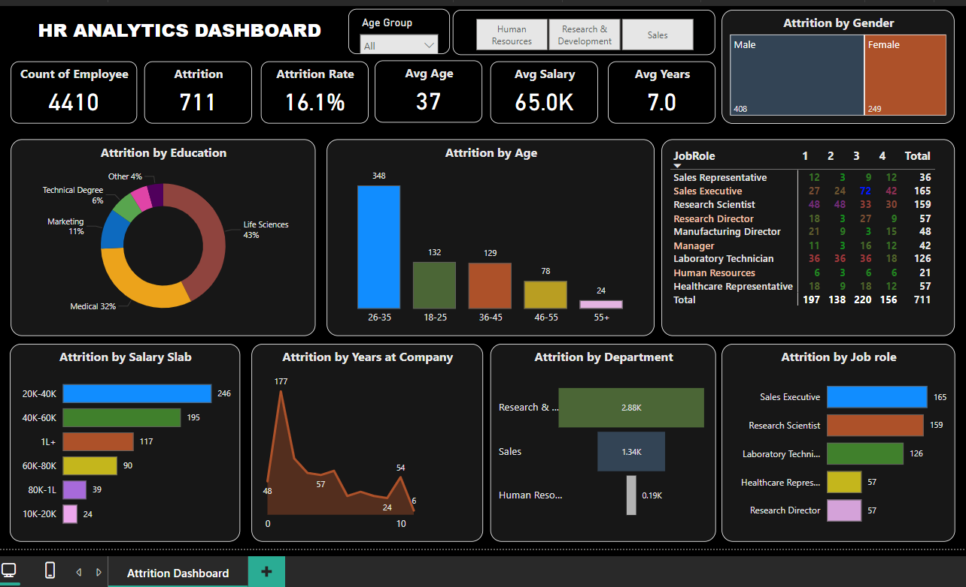
Power BI Dashboard Overview
Key Dashboard and Reports:
Attrition Overview: General trends and overall attrition rate.
Department Analysis: Attrition rates by department.
Demographic Insights: Attrition by age, gender, and education.
Job Role and Performance: Attrition analysis based on employee Job role and performance rating.
Interactivity: Slicers and filters to drill down into specific attributes (e.g., department, age group).
GITHUB LINK : https://github.com/BhagyasreeTambole

Slide 7
Key Insights and Findings on Attrition
Education-Related Attrition: Higher attrition rates are observed in employees with degrees in Life Sciences and Medical fields compared to other educational backgrounds.
Age-Related Attrition: Employees aged 26-35 and 18-25 exhibit higher attrition, indicating potential challenges in retention among younger and early-career professionals.
Salary Influence on Attrition: Attrition is notably high in the salary brackets of 20k-40k and 40k-60k, suggesting potential dissatisfaction or better opportunities in these ranges.
Tenure at Company: Significant attrition occurs at 1 year, 2 years, and 10 years, highlighting critical points where employees are more likely to leave.
Departmental Trends: The Research and Development and Sales departments experience the highest attrition rates, while Human Resources shows relatively lower turnover.
Job Role Attrition: Key roles with high attrition include Sales Executive, Research Scientist, and Laboratory Technician, pointing to potential role-specific challenges.
Job Satisfaction Ratings: Despite being in high attrition roles, employees in the Research Scientist and Laboratory Technician positions report higher job satisfaction, while Sales Executives frequently rate their satisfaction at 1 or 2, indicating dissatisfaction.
Gender Distribution: Male employees show higher attrition (408) compared to female employees (249), suggesting a need for targeted retention strategies.

Slide 8
Conclusion
Conclusion:
The analysis shows that younger employees, especially those in Life Sciences and Sales, are leaving the company at higher rates. It's clear that salary and job satisfaction play big roles in their decisions to stay or go.
Recommendations:
To keep our talent, we should focus on younger workers and those earning between 20k-60k, providing them with better support and growth opportunities. Let’s also work on improving job satisfaction in Sales and Research and Development by listening to employee feedback. Lastly, addressing the higher attrition rates among men can help create a more inclusive workplace where everyone feels valued.

Slide 9
Netflix Data Analysis
Name : T Bhagya sree
Date : 08-10-2024

Slide 10
Agenda
Overview of Netflix
Project Objective
Tools Used/Power BI Features Utilized
Dashboard Overview
Key Findings
Conclusion

Slide 11
Overview of Netflix
Netflix is a subscription-based streaming service that allows our members to watch TV shows and movies on an internet-connected device.
Founded in 1997, based in Los Gatos, CA.
Global leader in streaming services.
Extensive library of films, TV shows, documentaries, and original content.

Slide 12
Project Objective
Goal:
Analyze Netflix viewership data to identify trends and patterns.
Specific Aims:
Understand audience demographics.
Evaluate content performance.
Assess regional differences in viewership.

Slide 13
Tools Used/Power BI Features Utilized
Power BI:
Business intelligence tool for data visualization.
Enables interactive dashboards and reports.
Power BI Features Utilized
Data Transformation:
Power Query for data cleaning and preprocessing.
Visualizations:
Bar and line charts for trends.
Also used Area and pie charts for more analysis.

Slide 14
Tools Used/Power BI Features Utilized
EDA & Data Cleaning :
Loaded data into Power BI desktop and then transformed into power query editor
& performed data cleaning.
Done Column Profiling and encoded nulls and imputed some columns with mode value (average value)
Formatted Date column, by changing its Locale
Added duration custom column, used conditional column to extract minutes into the new or custom column to only get the information of minutes.
Splitted the listed in column, duplicated the data and then used primary key column which is show_id and listed_in column and then splitted into rows by delimiter to get the category or genre.
Lastly Filtered data (subset of data) within power query and applied number filter to release year column to show data from 2000 year.
And Loaded Data into Power Bi, done data visualization, created charts, reports and built Interactive Dashboard.

Slide 15
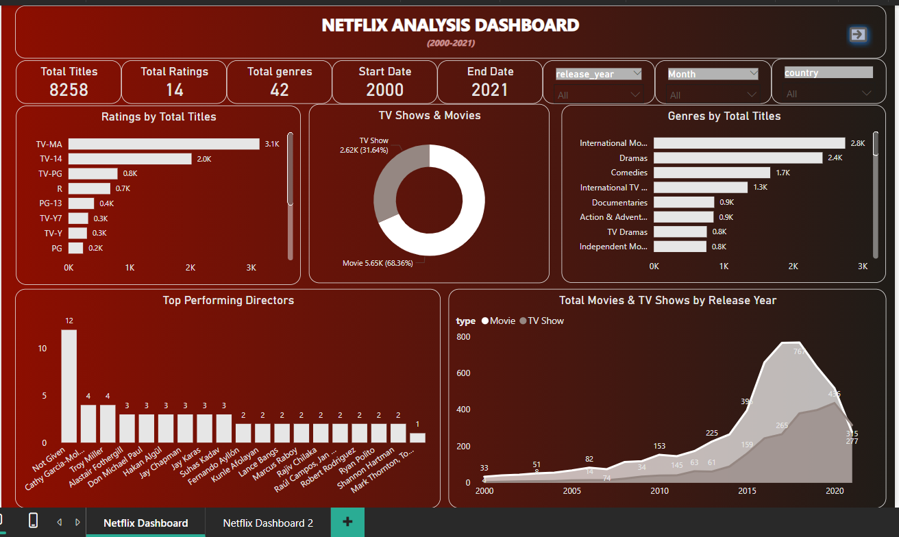
Power BI Dashboard Overview
Key Dashboard and Reports:
Ratings by Total Titles: Visual representation of average ratings categorized by movies and TV shows.
Genres by Total Titles: Bar graph showing the distribution of titles among various genres, such as dramas, comedies, and international Movies.
Top 10 Performing Directors: A leaderboard highlighting the best-performing directors based on the number of titles released.
Total Movies and TV Shows by Release Year: The Area chart illustrating the number of titles released each year from 2000 to 2021, showcasing growth trends.
Interactivity: Slicers and filters to drill down into specific attributes (e.g., release year, Month, country).

Slide 16
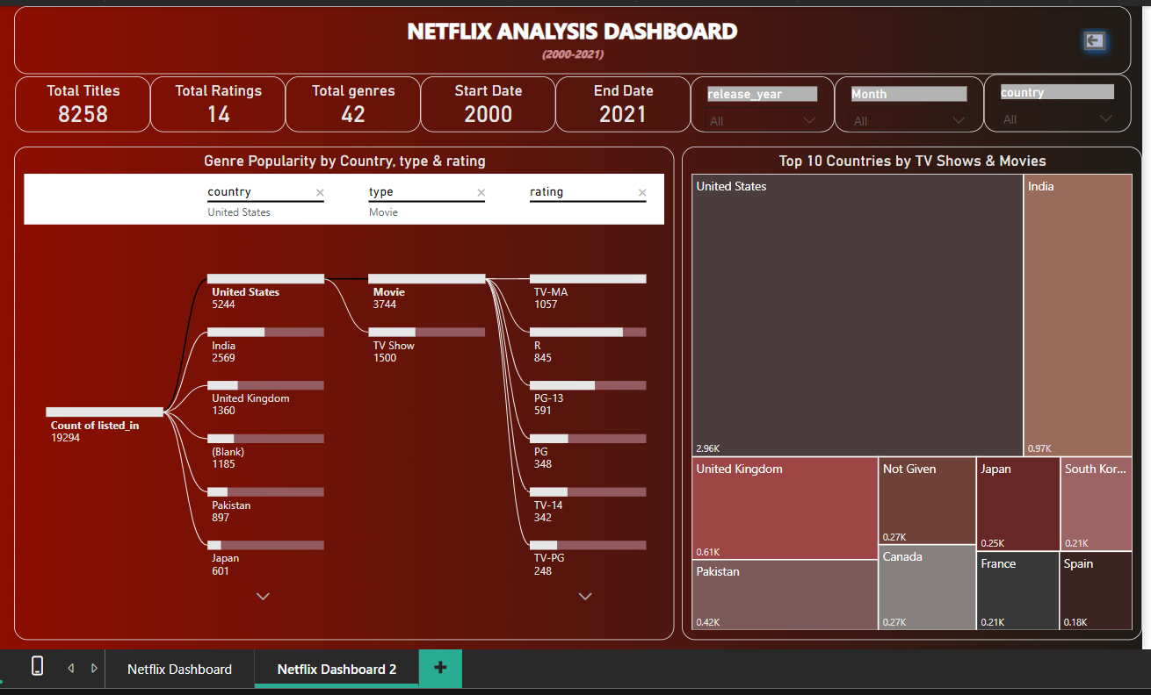
Power BI Dashboard Overview
Key Dashboard and Reports:
Decomposition Tree Visualization:
Genre Popularity : An interactive decomposition tree that visualizes genre popularity segmented by country, type (TV shows and movies), and rating. Users can drill down to explore how different genres perform across various countries and their average ratings.
Top 10 Countries : The Treemap showcasing the top 10 countries producing the most TV shows and movies, allowing for quick comparisons of content output and genre preference.
GITHUB LINK https://github.com/BhagyasreeTambole

Slide 17
Key Insights and Findings
Content Split: Netflix's catalog is dominated by movies, making up 68.36% of the total titles, while TV shows account for 31.64%.
Popular Genres: The most common genres include International Movies, Dramas, and Comedies.
Top Directors: The top-performing directors based on the number of titles are Cathy Garcia and Troy Miller.
Release Trends:
In 2000, Netflix released only 33 movies and 4 TV shows.
There was a steady increase in content releases from 2000 to 2015.
From 2015 onwards, Netflix saw a rapid surge in the number of TV shows and movies released.
Leading Countries: The top 10 countries producing Netflix content include the United States, India, and UK among others.

Slide 18
Conclusion
Summary of Insights:
Data analysis provides a clearer picture of viewer preferences.
Future Recommendations:
Tailor content offerings based on audience insights.
Monitor ongoing trends for continuous improvement.

Slide 19
THANK YOU

